Slide 1
_{Peapack Investments Ltd}
Private Equity: The Essential Asset Class For High Net Worth Investors
Maximus Capital
XIV Annual International Banking Forum CEE/CIS
Family Office, Private Wealth and Treasury Management
February 2014, Riga, Latvia

Slide 2
_{Peapack Investments Ltd}
ALL YOU NEED TO KNOW
10 Year Private Equity Returns: 12.3%
10 Year S&P 500 Returns: 5.3%
Source: Prequin, Private Equity Performance vs. S&P 500, February 2013

Slide 3
_{Peapack Investments Ltd}
OTHER ALTERNATIVES
If an investor put 60 per cent of their money into a Vanguard index fund tracking the S&P 500, the other 40 per cent into its Bond Market Index fund, and re-balanced it once a year, they made 7.4 per cent a year over the last decade. The average hedge fund made 5.8 per cent, on HFR numbers.
Forbes, September, 2013

Slide 4
_{Peapack Investments Ltd}
NOT A MYSTERY
The reason for private equity investment performance is not a mystery and it can be achieved with careful manager selection.
Private equity commonly is:
- Purchased after proper due diligence
- Purchased at a lower purchase prices
- Actively managed for growth and valuation
- Sold at higher sales prices (control premiums)
- Properly timed for purchase and sale

Slide 5
_{Peapack Investments Ltd}
ISSUE
Liquidity, Liquidity, Liquidity

Slide 6
_{Peapack Investments Ltd}
ISSUE
Liquidity, Liquidity, Liquidity
ANSWER
Asset Allocation

Slide 7
_{Peapack Investments Ltd}
Calpers Asset Allocation / Targets
October 2013
Amount Percent Target
Public Equity $152 billion 55% 50%
Income $41 billion 15% 17%
Private Equity $31 billion 11% 14%
Real Estate $24 billion 9% 9%
Liquidity $11 billion 4% 4%

Slide 8
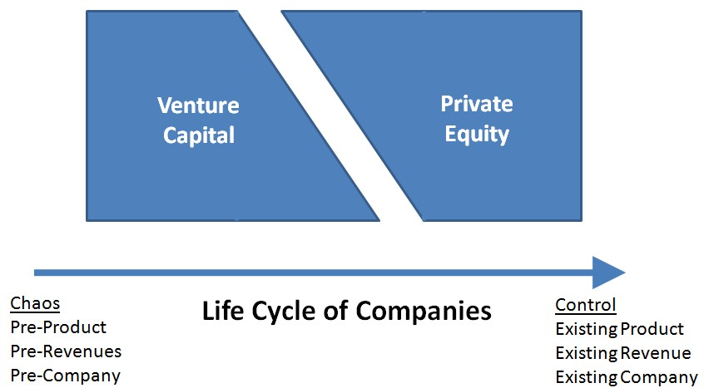
_{Peapack Investments Ltd}
WHAT IS PRIVATE EQUITY ?

Slide 9
_{Peapack Investments Ltd}
 | Private Equity | Venture Capital
Environment | Control | Chaos
Medium | Numbers | Human Beings
Primary Hard Tool | Buying and selling stock | Buying and selling stock
Primary Soft Tool | Operational Efficiency | Human Motivation
Primary Lever | Optimized Structure | Disruptive Innovation
Primary Investment Trigger | Underutilized Assets | Team
Direction of Value Creation | Top-down | Bottom-up
Economic Philosophy | Neoclassical Economics | Innovation Ecosystems (“Rainforests”)
Assumption | Rational Actors | Irrational Actors
Role of Probability | Precision | Serendipity
Model | Deming/TQM, Six Sigma | Silicon Valley
Parallels | Classical music, Fine arts, Farms, Assembly lines | Jazz, Street art, Rainforests, Design thinking

Slide 10
_{Peapack Investments Ltd}
HOW TO INVEST IN PRIVATE EQUITY
Fund of Funds
Fund Manager Selection
Fund Focus: Size, Industry(ies), Geography
Investor Position

Slide 11
_{Peapack Investments Ltd}
HOW TO INVEST IN PRIVATE EQUITY
Investor Position
Relationship to Management
Relative Size of Fund / Investment in Fund
Co-Investment Rights
Fees, Participation in the GP

Slide 12
_{Peapack Investments Ltd}
BESPOKE INVESTMENT OPPORTUNITY
Peapack Investments Ltd. (PI) is an investment advisory company formed primarily to establish selected private equity funds with world class fund management firms and management teams in Central and Eastern Europe, and to lead selected financings for worthy companies in the Enterprise Investment Scheme (EIS) market in the UK.
PI has been formed by Peapack Asset Management (PAM), an investment management company whose shareholders include prominent United States based investors / investment managers.

Slide 13
_{Peapack Investments Ltd}
BESPOKE INVESTMENT OPPORTUNITY
PI is offering investors “of size” co-investment rights in all the investments made by funds sponsored by PI and investments arranged by PI.
Co-investors will not have to commit capital to closed end funds, will be able to “cherry-pick” among the available investments and private equity fund investments, and will receive preferential management fee and carried interest terms as compared to the fund investors.

Slide 14
_{Peapack Investments Ltd}
INITIAL SELECTED PRIVATE EQUITY FUNDS
CEETRU CAPITAL PARTNERS
An up to Euro 100 million private equity fund focused on Poland, “the sweet spot of Europe” as well as making investments in other countries in Central and Eastern Europe, Turkey, Russia and Ukraine. The Fund will be partnered with Warsaw Equity Group, the most successful SME PE investor in Poland, which has achieved an IRR of 164% on its exited investments to date across its 20 year track record).

Slide 15
_{Peapack Investments Ltd}
INITIAL SELECTED PRIVATE EQUITY FUNDS
PGG REAL ESTATE INVESTORS
An up to $200 million private equity fund focused on Warsaw real estate, which anticipates up to $200 million of near term investments in new and refurbished offices and multi-family buildings, targeting 22% IRRs with exits through German retail syndications.
The Fund is to partner with Golub & Co. (Chicago), and its affiliate in Poland, where it is currently managing $50 million for Polish institutions.

Slide 16
_{Peapack Investments Ltd}
ADDITIONAL INVESTMENT OPPORTUNITIES
THE UK EIS MARKET
PI will also lead investments in the UK EIS market in worthy companies from the UK, the US and emerging Europe. As a sponsor of the investments, PI will be able to “cherry-pick” from the best opportunities in the UK market and will bring new opportunities to the EIS market from the US and emerging Europe.
PI has already launched Enterprise Peapack EIS Fund I.

Slide 17
_{Peapack Investments Ltd}
PI ECONOMICS
PI will gain an up to 20% Sponsorship Interest in the Management Fees and Carried Interests of the funds and investments PI sponsors.
Day to day management of PI will be provided by management companies allowing PI to have limited overheads. Expenses incurred in creating private equity funds and leading financings will be reimbursed at the closing of the funds and investments created and led by PI.

Slide 18
_{Peapack Investments Ltd}
INVESTOR BENEFITS
PI will be able to pay dividends to its shareholders from its Management Fees and Financing Fees during its life, and prior to the realization of PI Carried Interest participations in the sponsored funds and investments.
Illustrative returns for PI investors on a base case create an IRR of 38% for EIS qualified investors. If NO private equity funds are created, the low case, the IRR is still 26%. Non-EIS advantaged returns would be 31% and 20% respectively.
PI management believes the illustrative cases are conservative.

Slide 19
_{Peapack Investments Ltd}
OTHER KEY CONSIDERATIONS FOR INVESTORS
CEETRU and PGG Real Estate Funds create investment partners for private equity and real estate opportunities.
Peapack management, advisors and relationships create opportunities to work together on structuring transactions with investors – including raising capital and identifying expansion opportunities for investors.
Activities may lead to follow on funds managed in partnership with investors.

Slide 20
_{Peapack Investments Ltd}
OTHER KEY CONSIDERATIONS FOR INVESTORS
INVESTMENT AND DIVERSIFICATION BENEFITS
Co-investment rights across Peapack activities creates attractive investment opportunities across Central Europe, as well as in the UK and the US.
Peapack management, advisors and relationships create opportunities to consider new investment activities across Central Europe, as well as in the UK and US.

Slide 21
_{Peapack Investments Ltd}
An Information Memorandum on Peapack Investments Ltd is available from the Company.
PEAPACK INVESTMENTS LTD
Apsley House
176 Upper Richmond Road
London SW15 2SH
Tel: +44 8780 0883

