Slide 1
Investment Opportunities in Online Consumer Finance
Matiss Ansviesulis
Co-Founder
Creamfinance LLC
Riga, 21/02/2014

Slide 2
Consumer finance is no longer about banks only
?
Notes:
Sarkanaa – japadoma kas tiesi ir mums visrasturigakas ipasibas

Slide 3
Symbols of change in consumer finance
?
?
?
Notes:
Sarkanaa – japadoma kas tiesi ir mums visrasturigakas ipasibas

Slide 4
Symbols of change in consumer finance
?
Online based
?
Notes:
Sarkanaa – japadoma kas tiesi ir mums visrasturigakas ipasibas

Slide 5
Symbols of change in consumer finance
Focused on User Experience
Online based
?
Notes:
Sarkanaa – japadoma kas tiesi ir mums visrasturigakas ipasibas

Slide 6
Symbols of change in consumer finance
User experience focused
Online based
Driven by startups
Notes:
Sarkanaa – japadoma kas tiesi ir mums visrasturigakas ipasibas

Slide 7
Investing in Fintech
Consumer finance
Online
FINTECH
Notes:
Sarkanaa – japadoma kas tiesi ir mums visrasturigakas ipasibas

Slide 8
Investing in Fintech
Mobile
Notes:
Sarkanaa – japadoma kas tiesi ir mums visrasturigakas ipasibas

Slide 9
Investing in Fintech
Mobile
Crowd - Funding
Notes:
Sarkanaa – japadoma kas tiesi ir mums visrasturigakas ipasibas

Slide 10
Investing in Fintech
Mobile
Peer – 2 – Peer
Crowd - Funding
Notes:
Sarkanaa – japadoma kas tiesi ir mums visrasturigakas ipasibas

Slide 11
Investing in Fintech
Mobile
Peer – 2 – Peer
Crowd - Funding
Consumer Lending
Notes:
Sarkanaa – japadoma kas tiesi ir mums visrasturigakas ipasibas

Slide 12
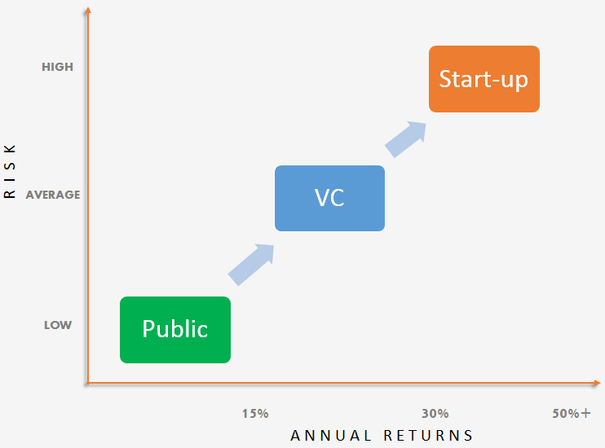
Summary – Investment Strategies
Traditional Consumer Finance
Fintech
Notes:
Sarkanaa – japadoma kas tiesi ir mums visrasturigakas ipasibas

Slide 13
Contact details
T H A N K Y O U
Matiss Ansviesulis
Tel.: +371 29611117
E-Mail: matiss.ansviesulis@creamfinance.com

